Slide 1


Slide 2

A Parent's Prayer
Lord, we pray for our children knowing that you care and watch over each of them completely.
Please encircle them with your great love and protection. Guide their pathways and walk beside them always. Minister by your Holy Spirit into their hearts and souls and bring your peace.
Bless them with goodness, come open their minds to the wonder and beauty of life.
Sow into their lives great heavenly treasure so they might carry light in their hearts and joy in their spirits.
Lord, may they understand more and more of your love for them.
May they appreciate themselves as you see them - unique and precious.
Father, please come and cover our parenting with your amazing love.
In Jesus name, Amen.

Slide 3

Parent Information Meeting
Autumn 2025

Slide 4
Meet the team…
Mrs Mawdsley
Mon-Thurs
Mrs Currell
Mon-Thurs
Mrs Claridge
Class 1C
Mrs James
Class 1J
Mrs Wasniowska
Friday only
Mrs Meni
Friday only
Mrs
Davies

Slide 5
Curriculum
Our medium term plan will be on our website soon. This will be a guide of the topics that we will cover.
We will also include the Knowledge organisers for each subject that you can go through with your child.
PE - Thursday and Friday
Forest School - Wednesday

Slide 6

Reading

Slide 7



Reading
We teach reading through phonics.

Slide 8
Reading
As well as Phonics, Guided Reading will take place in school. Your child will read in a session with their class teacher at least once a week but with an adult every session.

Slide 9
Reading
PHONICS AND READING SUPPORT FROM HOME IS KEY!
Phonics and reading should be practised every night. By the end of the week your child should be reading the book confident and showing fluency.
We do expect you to record that you have listened to your child read and record it in the Reading record.
If your child is not reading regularly at home, we will arrange a meeting with you to discuss this further.
We will change books on a Thursday.

Slide 10
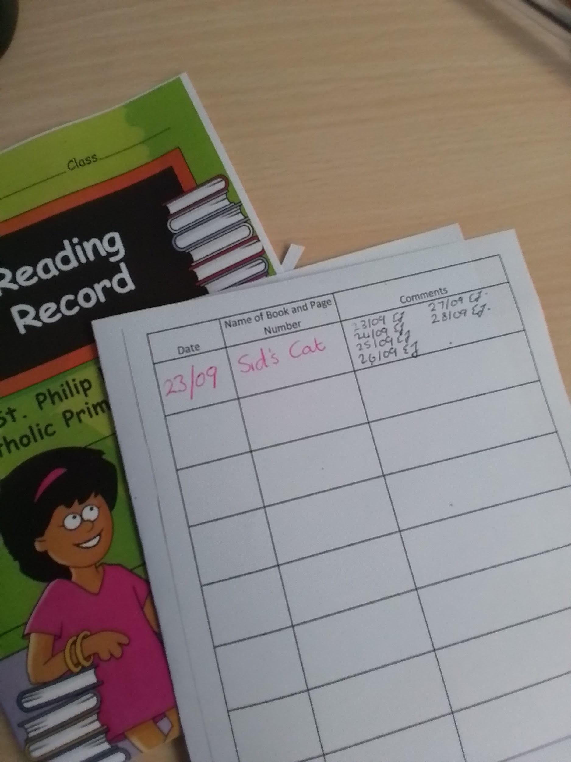
Reading
PHONICS AND READING SUPPORT FROM HOME IS KEY!
If your child is not reading regularly at home, we will arrange a meeting with you to discuss this further.

Slide 11
Why does it make such a difference?
Increases their vocabulary
Develops their attention span
Improves their general knowledge
Makes them better writers.
How can you help?
Join the library, it’s free - go online (search ‘Hatfield Library’ & follow the link) or go into the library (closed on Sunday/Thurs)
If you are a library member you will also have access to free audio books through ‘BorrowBox’. Good for bedtime listening & it develops their vocabulary.
Read to your children and show them that you love books by reading yourself.

Slide 12
Homework
Phonics homework; each week the children will have learnt new sounds and tricky words. These can be found on google classroom. They should be revised every night.
Games and books will be available on Bug Club
Homework grids will be sent home with your child in their reading record each half term.
There is a copy on the website and on Google classroom.
They are expected to complete a square (and activity) a week.
Children’s homework will be shared and celebrated with the class.

Slide 13
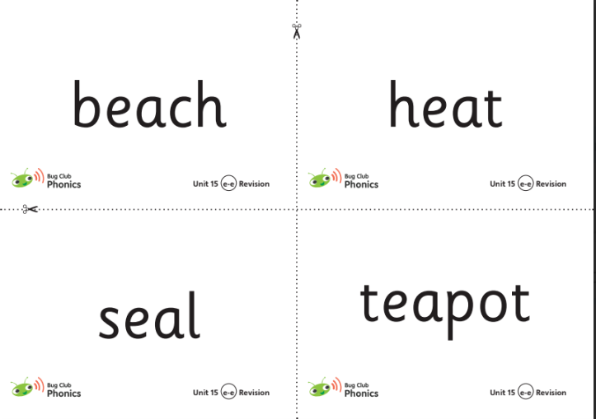
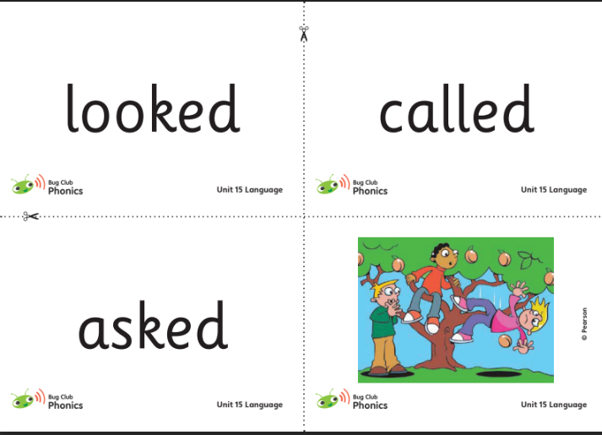
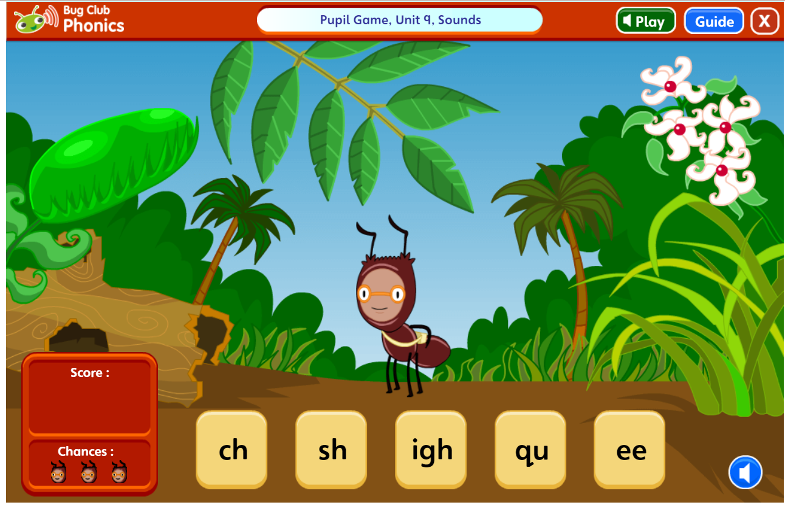
Homework

Slide 14
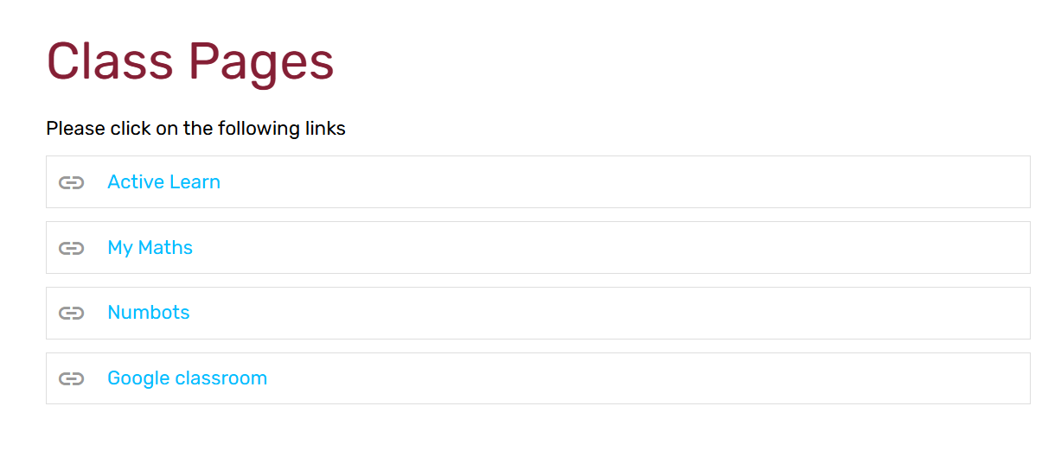
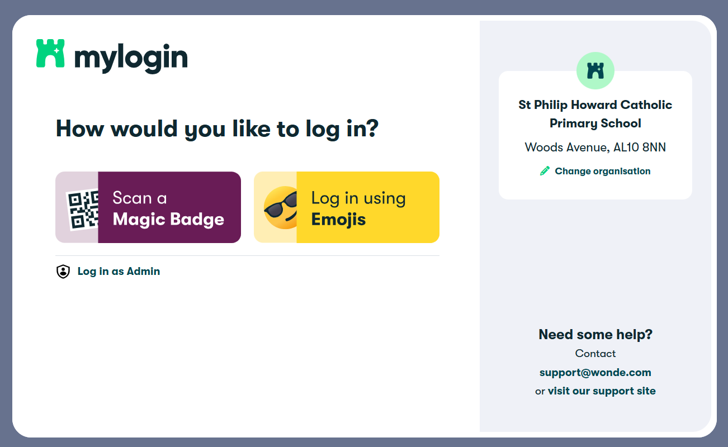

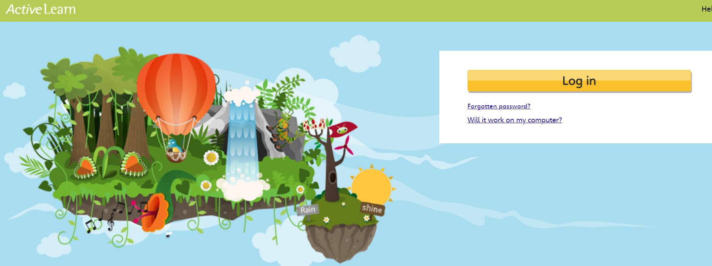
Homework

Slide 15
Yr 1 Phonics Screening
Your child will take part in the phonics screening check in June.
The phonics screening check is a check of your child’s phonics knowledge. It helps your school confirm whether your child is making the progress expected in the national curriculum.
The phonics screening check contains 40 words divided into two sections of 20 words. Both sections contain a mixture of real words and pseudo-words.
The results will be given out as part of the end of year report.

Slide 16
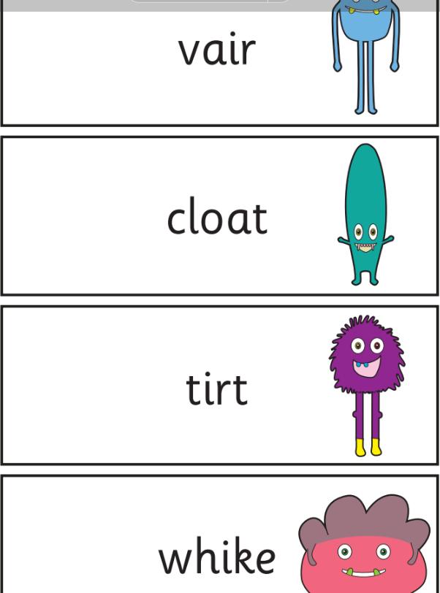
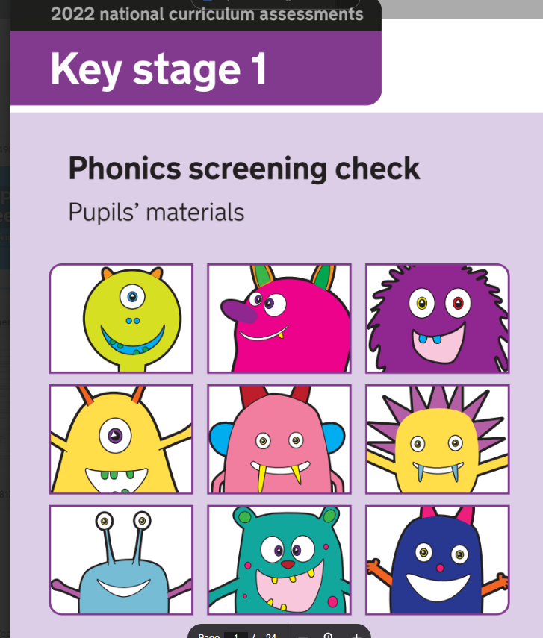
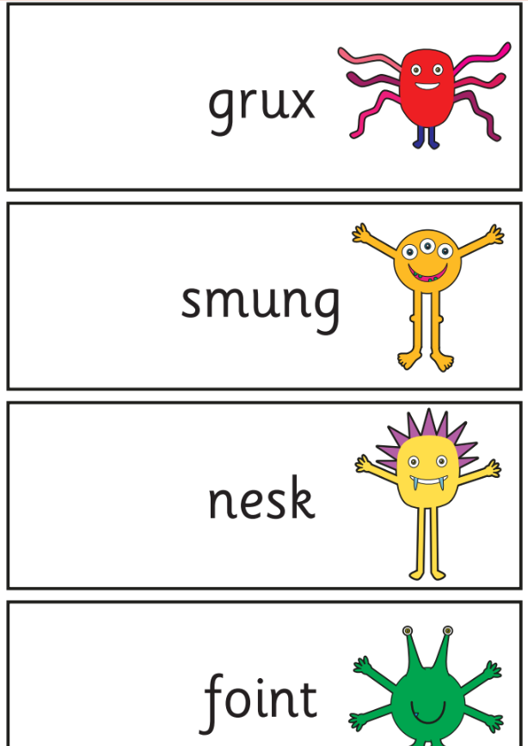
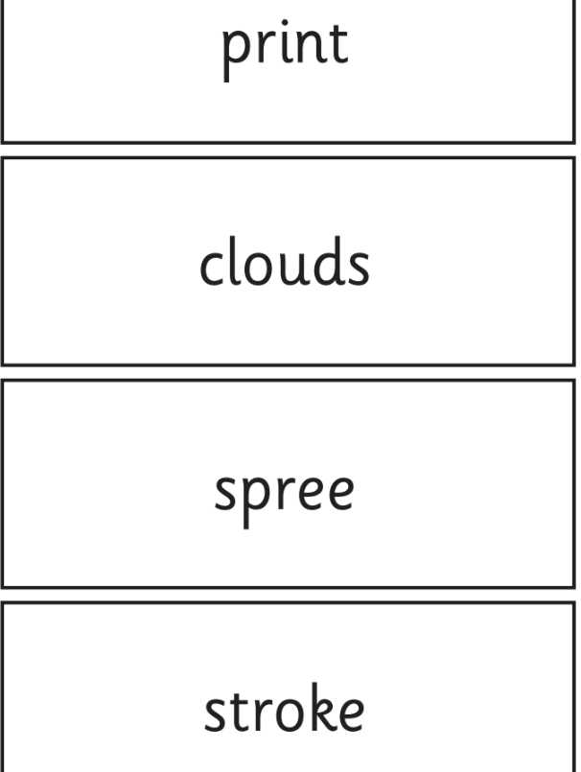
Yr 1 Phonics Screening

Slide 17
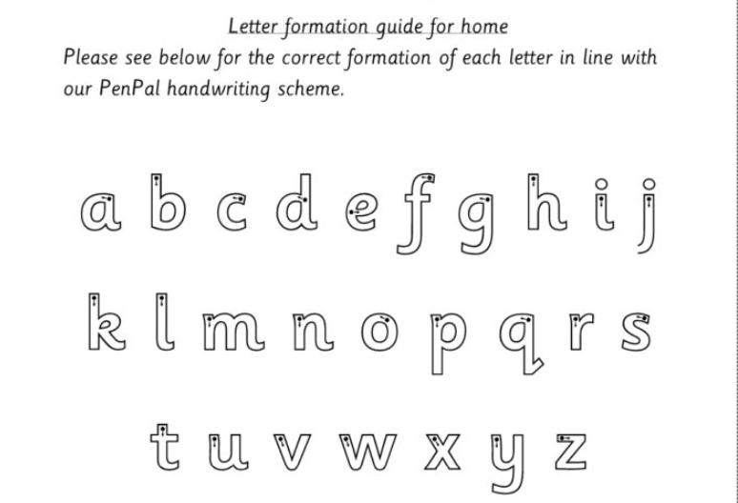

Slide 18
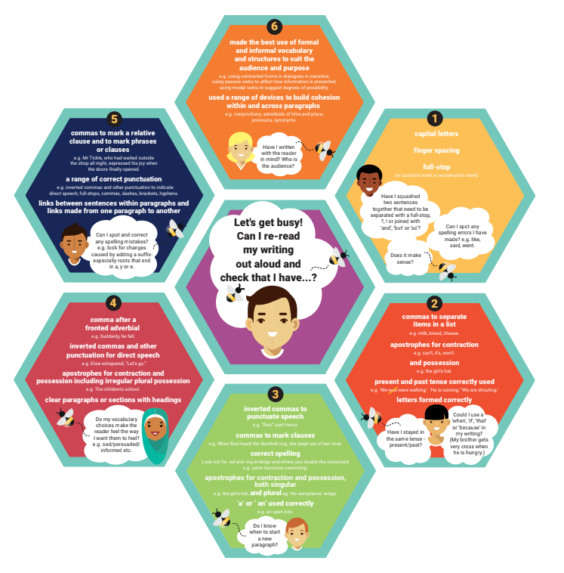

Slide 19
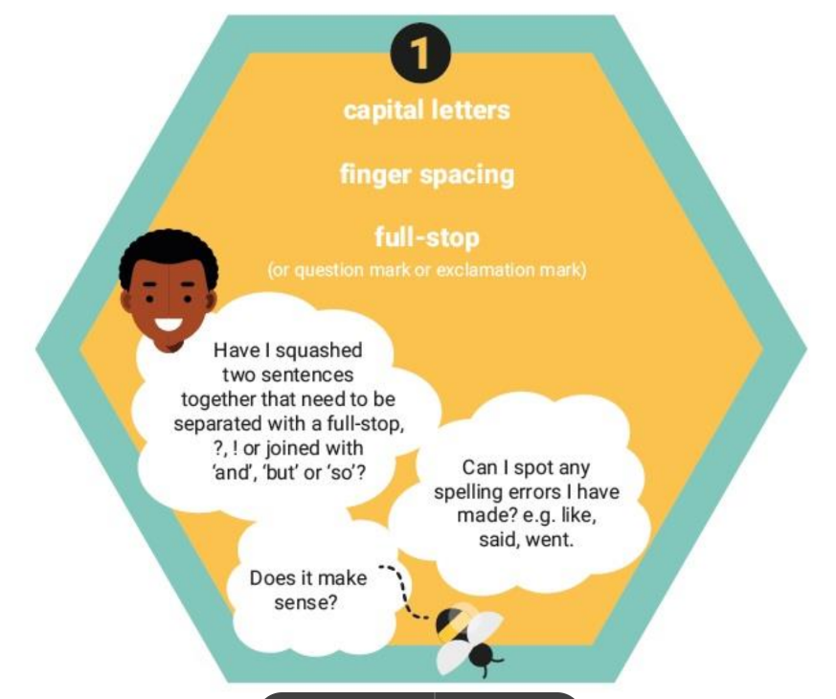

Slide 20
School Uniform
School uniform is listed on the school website
Long hair (both boys and girls) must be tied back
No large bows or accessories are allowed
Earrings must be studs / no nail varnish
Only school book bags are allowed
Uniforms, PE kit and book bags must be clearly labelled with your child’s name
Girls must have socks for PE
PE kits must be worn on PE and Forest school days.

Slide 21
Attendance
Children come into class at 8:40
The class register closes at 8:45am. If your child is late they must enter through the front office.
School ends at 3:15pm and any children not collected they are sent to the office (Mrs Waugh’s office)
No holidays during term time will be authorised
Medical treatment abroad requires a covering NHS letter

Slide 22
Sickness
Please phone the school office by 9:30am if your child is unwell and give the reason for their absence as some illnesses are contagious
If your child has vomited, or has had diarrhoea, they must be 48 hours clear before returning to school

Slide 23


e-safety
ICT including the internet, email and mobile technologies has become an important part of learning in our school. We want all children to be safe and responsible when using any ICT. During computing and PSHE lessons pupils will learn about e-safety.
Please take care to ensure that appropriate systems are in place at home to protect and support your child. Each year, there are increasing numbers of social media issues and this is usually because the children involved are accessing sites that should not be used until the age of 13 – for example, Facebook,TikTok, Snapchat and Instagram. WhatsApp has now changed to 16+. Please ensure your child does not have access to these apps and please regularly monitor their devices.
If you have any concerns or would like some advice please contact Mrs Waugh, Mrs Field or Mrs Gajjar.

Slide 24
Communication
If you have any concerns, please speak initially to your child’s class teacher
Your class teacher will refer you to the leadership team if necessary
Appointments to see your child’s teacher can be arranged through the school office
Teachers are only available after school (except on Wednesday).

Slide 25
Playground Safety
Children are not allowed to use the Trim Trail before and after school.
No ball games, riding of bikes and scooters on the playground before and after school.

Slide 26
New email communication
1C and 1J
SPHYear1@sphoward.herts.sch.uk
Mrs Field and Miss Davies ( Special Needs Questions and Information)
senco@sphoward.herts.sch.uk
Mrs Waugh, Headteacher head@sphoward.herts.sch.uk

Slide 27
Safeguarding
Please support us in keeping our school a safe place
To this end, parents will only be able to access the school building via the school office at all times

Slide 28
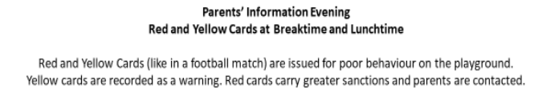
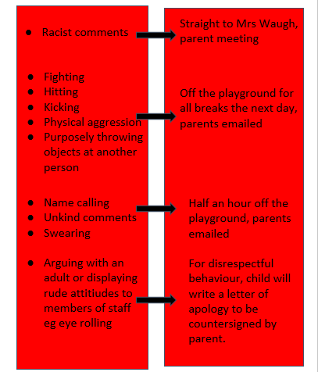
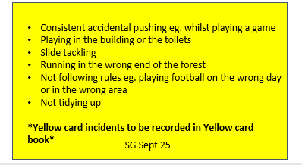

Slide 29
Key Dates
Reading books will be changed on a Thursday.
Phonics and reading should be practised every night at home.
Friday 19th September - Family BBQ - 3.30 pm - 6.00 pm.
Monday 20th and Tuesday 21st October- Parent consultations.
Finish on Wednesday 22nd October 1.00pm.
Friday 17th October - Mass.
Year 1 Phonics screening June. (Results will come out in end of Year report.)

Slide 30
Partnership
We very much look forward to working in partnership with you and your child over the coming year and we thank you for your continued support of our school.

