Slide 1
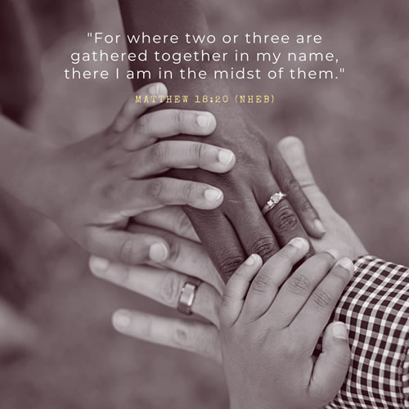

Slide 2

A Parent's Prayer
Lord, we pray for our children knowing that You care and watch over each of them completely.
Please encircle them with Your great love and protection. Guide their pathways and walk beside them always. Minister by your Holy Spirit into their hearts and souls and bring your peace.
Bless them with goodness, come open their minds to the wonder and beauty of life.
Sow into their lives great heavenly treasure so they might carry light in their hearts and joy in their spirits.
Lord, may they understand more and more of your love for them.
May they appreciate themselves as you see them - unique and precious.
Father, please come and cover our parenting with Your amazing love.
In Jesus’ name, Amen.

Slide 3

Parent Information Meeting
Autumn 2026

Slide 4
Meet the team…
Mrs Robu-Popescu
Mrs Prisacaru
Mrs Nicholas
Mrs Ives
Class 2I
Mrs Hulley
Class 2H
Mrs Mawdsley
Mrs Chukwunyerenwa
Tuesday
Mrs Young
Tuesday
Mrs Cochlin

Slide 5
Curriculum
Our medium term plan is now on the website. This is a guide of the topics that we will cover.
We will also include the Knowledge organisers for each subject that you can go through with your child.

Slide 6
Reading
Guided Reading will take place daily in school, during whole class guided reading.
It is also important that your child reads regularly at home. We expect every child to be reading at home, at least 4 times a week.
Children can reads books available on Bug Club too. These will be updated regularly by your child's teacher. Please make sure you sign their Reading Record every time they read, so we can monitor how much they are reading at home.
If your child is not reading regularly at home, we will arrange a meeting with you to discuss this further.
Books will be changed once a week on a Monday.

Slide 7
Reading at home
Remember to spend as much time talking about the book as reading the book:
  What is happening?
  What might happen next?
  Why did the character act like that?
  What is your favourite part and why?

Slide 8

Why does it make such a difference?
Increases their vocabulary
Develops their attention span
Improves their general knowledge
Makes them better writers.
How can you help?
Join the library, it’s free - go online (search ‘Hatfield Library’ & follow the link) or go into the library (closed on Sunday/Thurs)
If you are a library member you will also have access to free audio books through ‘BorrowBox’. Good for bedtime listening & it develops their vocabulary.
Read to your children and show them that you love books by reading yourself.

Slide 9
Homework
Homework- Your child will receive Maths homework to complete twice a week.
There will be an English activity to complete as well.
RE homework to be completed once a term.
The Homework will come home in a folder.
They will receive it on a Monday, to be handed in on Wednesday and Friday.
We will mark it together as a class.

Slide 10
School Uniform
School uniform is listed on the school website
Long hair (both boys and girls) must be tied back
No large bows or accessories are allowed
Earrings must be studs / no nail varnish
Only school book bags are allowed
Uniforms, PE kit and book bags must be clearly labelled with your child’s name
Girls must have socks for PE
PE kits must be worn on PE and Forest School days.
Please send your child in with a pair of NAMED wellies for Forest School.

Slide 11
Attendance
Children come into class at 8:40am
The class register is taken at 8:50am. If your child is late they must enter through the front office.
School ends at 3:15pm and any children not collected by 3:25pm will be sent to After School Club and you will be charged.
No holidays during term time will be authorised.
Medical treatment abroad requires a covering NHS letter.

Slide 12
Sickness
Please phone the school office by 9:30am if your child is unwell and give the reason for their absence as some illnesses are contagious.
If your child has vomited, or has had diarrhoea, they must be 48 hours clear before returning to school

Slide 13


e-safety
ICT including the internet, email and mobile technologies has become an important part of learning in our school. We want all children to be safe and responsible when using any ICT. During computing and PSHE lessons pupils will learn about e-safety.
Please take care to ensure that appropriate systems are in place at home to protect and support your child. Each year, there are increasing numbers of social media issues and this is usually because the children involved are accessing sites that should not be used until the age of 13 – for example, Facebook,TikTok, Snapchat and Instagram. WhatsApp has now changed to 16+. Please ensure your child does not have access to these apps and please regularly monitor their devices.
If you have any concerns or would like some advice please contact Mrs Waugh, Mrs Field or Mrs Gajjar.

Slide 14
Communication
If you have any concerns, please speak initially to your child’s class teacher
Your class teacher will refer you to the leadership team if necessary.
Appointments to see your child’s teacher can be arranged through the school office
Teachers are only available after school (except on Wednesday).

Slide 15
New email communication
2I and 2H
SPHYear2@sphoward.herts.sch.uk
Mrs Field (Special Needs Questions and Information)
senco@sphoward.herts.sch.uk
Mrs Waugh, Headteacher head@sphoward.herts.sch.uk

Slide 16
Playground Safety
Children are not allowed to use the Trim Trail before and after school but under parental supervision and at your own risk.
No ball games, riding of bikes and scooters on the playground before and after school.

Slide 17
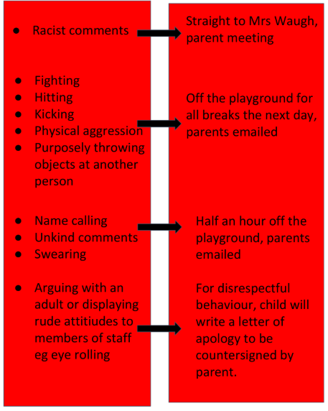
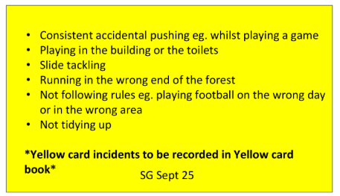

Slide 18
Key Dates
Reading books will be changed on a Mondays.
Homework in on a Wednesday and Friday.
Education Sunday service 11:30 Mass at St Peter’s Church.
Friday 18th September- Friends Community BBQ
Monday 19th & Tuesday 20th October - Parent consultations
Wednesday 21nd October - Term ends at 1 pm

Slide 19
Partnership
We very much look forward to working in partnership with you and your child over the coming year and we thank you for your continued support of our school.

